Slide 1
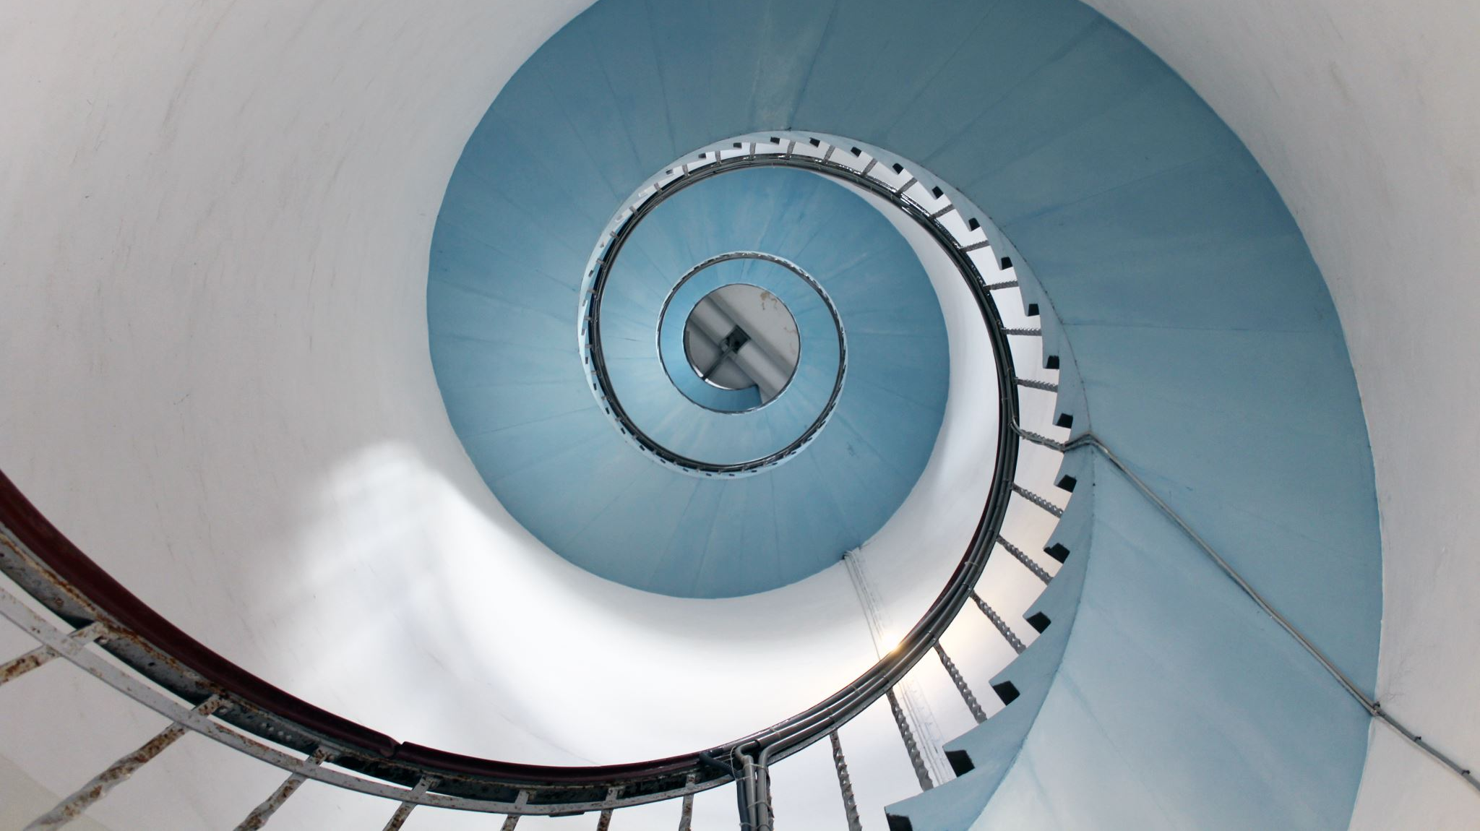
Functions and Graphs

Slide 2
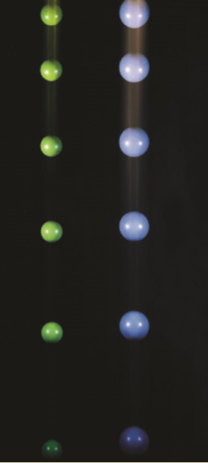
Why study this chapter?
Calculus is the mathematics that describes changes in functions.
The fundamental objects that we deal with in calculus are functions.
Functions are used as mathematical models of real-world phenomena.
For example, a ball falls faster and faster as time passes. Galileo discovered that the distance fallen is proportional to the square of the time it has been falling. Calculus then enables us to calculate the speed of the ball at any time.

Slide 3
Learning objectives
Determine the domain, range, and zeros of a function.
Analyze the symmetry of the graph of a function.
Create new functions from old functions.

Slide 4
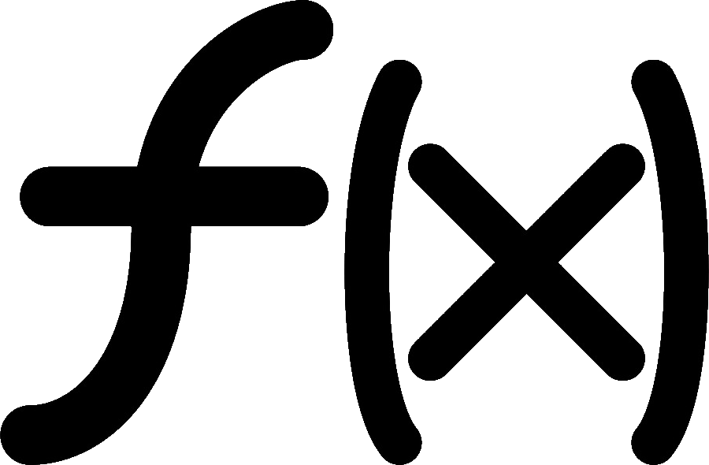

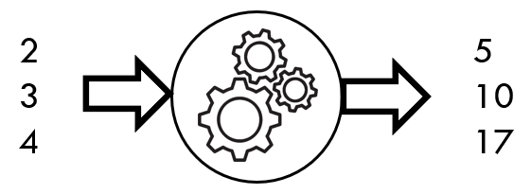
functions (= special rules)
function f consists of a set of inputs, a set of outputs, and a rule for assigning each input to exactly one output
⇨
⇨
Input | Output
2 | 5
3 | 10
4 | 17
Input
x
Output
y
•
Example
rule
•
f = {(2, 5), (3, 10), (4, 17)}
•
f(x) = x² + 1
x ∈ {2, 3, 4}

Slide 5
Functions – example
f(x) = x²
Rule: output is square of input
Input
Output

Slide 6
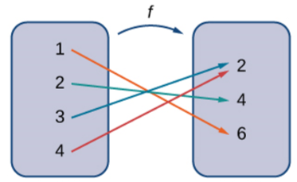
Functions – example
Input: 1, 2, 3, 4
Output: 2, 4, 6
Rule:
* 1 maps to 6
* 2 maps to 4
* 3 maps to 2
* 4 maps to 2

Slide 7
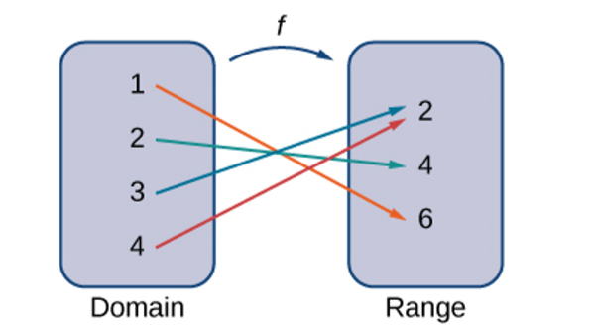
Domain and range
The set of inputs is called the domain of the function. The set of outputs is called the range of the function.
A function maps every element in the domain to exactly one element in the range. Although each input can be sent to only one output, two different inputs can be sent to the same output.

Slide 8
Graphs
We can also visualize a function by plotting points (x, y) in the coordinate plane where y = f (x). The graph of a function is the set of all these points
In this case, a graph of a function f has a domain of {1, 2, 3} and a range of {1, 2}.
The independent variable is x and the dependent variable is y.

Slide 9
The graph of the function f (x)=3-x with domain {1, 2, 3}. The graph consists of the points (x, f (x)) for all x in the domain
The graph of f (x) = 3 − x with domain R consists of the points (x, f (x)) for all x in the domain R

Slide 10
Example
the value of f(x) from the graph as being the height of the graph above the point
allows us to picture the domain of on the x-axis and its
range on the y-axis
The graph of a function f is shown in the Figure.
(a) Find the values of f(1) and f(5).
(b) What are the domain and range of f ?

Slide 11

Evaluating Functions
For the function f (x) = 3$x^{2}$ + 2x − 1, evaluate
Finding Domain and Range
For each of the following functions, determine the i. domain and ii. range.

Slide 12

Examples
Sketch the graph and find the domain and range of each function.
$\left(a\right) f\left(x\right)=2x−1$ $\left(b\right) f\left(x\right)=x^{2}$

Slide 13
Zeros of a function
If f(a) = 0, then a is called a zero of f.
Ex. Find all zeros of f(x) = x³ - 3x² + 2x.
x³ - 3x² + 2x = 0 ⇔ x = 0, x = 1, x = 2.
➔ Zeros of f are: 0, 1, 2
Ex 2. Finding Zeros and y -Intercepts of a Function

Slide 14
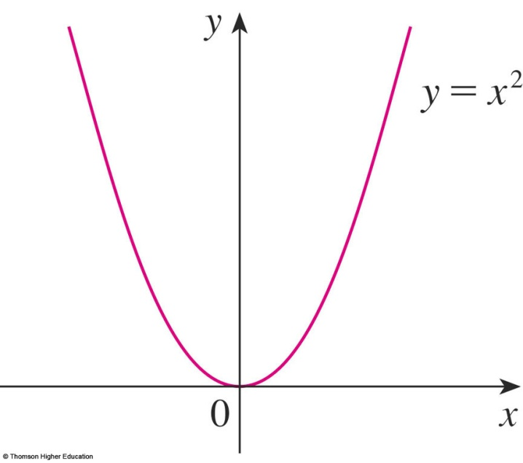
Symmetry of even functions
If f(-x) = f(x) for all x in domain
➔ f is an even function
➔ symmetry about the y-axis.
Symmetry about y-axis

Slide 15
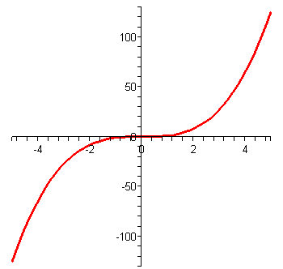
Symmetry of odd functions
If f(-x) = -f(x) for all x in domain
➔ f is an odd function
➔ symmetry about the origin
y = x³
Symmetry about the origin

Slide 16
Symmetry of odd functions

Slide 17
Example
Let f be an odd function. If the point (-3, 5) is on the graph of f, then which of the following points is/are also on the graph of f?
a.(3, 5) b.(-3, -5) c.(3, -5) d. None of these
✓
Even and Odd Functions
Determine whether each of the following functions is even, odd, or neither.

Slide 18
Odd or even or neither?
1/ f(x) = x² - 3
2/ g(x) = x³ + 4x
3/ h(x) = 3x/(x² + 4)
4/ k(x) = x⁴ - x

Slide 19
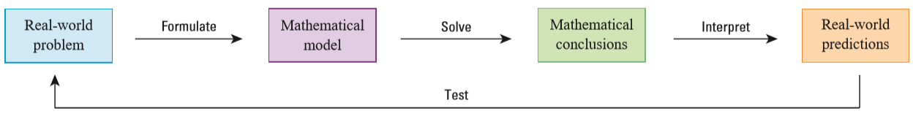
Common mathematical models
Linear models Polynomials
Power Functions Rational Functions
Trigonometric Functions Exponential Functions
Logarithmic Functions

Slide 20
Choose a reasonable model
P(t) is the human population of
the world at time t
t=0 corresponds to the year 1900

Slide 21
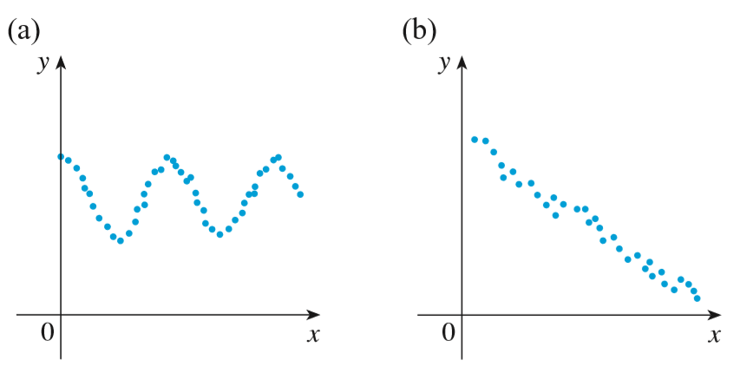
Choose a reasonable model
For each scatter plot, decide what type of function you might choose as a model for the data.

Slide 22
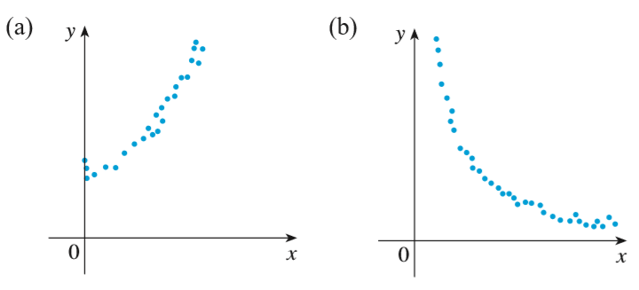
Choose a reasonable model
For each scatter plot, decide what type of function you might choose as a model for the data.

Slide 23
Combinations of Functions
f + g
f – g
f.g
f/g (g ≠ 0)

Slide 24

Example
Given the functions $f\left(x\right)=2x−3$and ${g\left(x\right)=x}^{2}−1$, find each of the following functions and state its domain.

Slide 25
Composite function g□f
Input
x
Function
f
Function
g
Output
y
function g□f
f
g
Ex. x 3 - x (3 - x)²
g(x) =

Slide 26
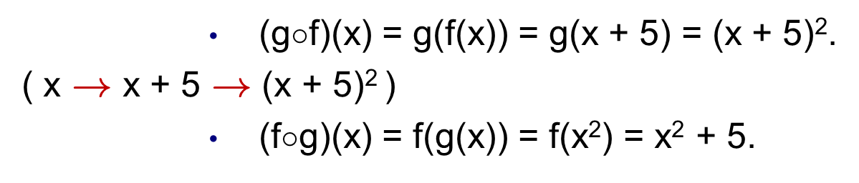
Composite functions – example
Given f(x) = x + 5 and g(x) = x², find g□f and f□g.

Slide 27
Compositions of Functions Defined by Formulas

Slide 28
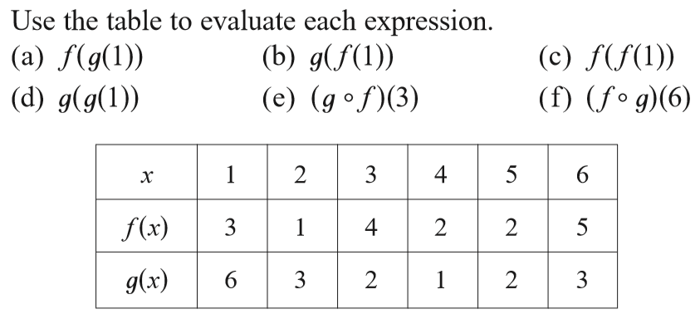
Composite functions – example
Composition of Functions Defined by Tables
f(g(1)) = f(6) = 5
1  6  5
(e) (g□f)(3) = g(f(3))
g
f

Slide 30
New functions from old functions
Shifting
Reflections

Slide 31
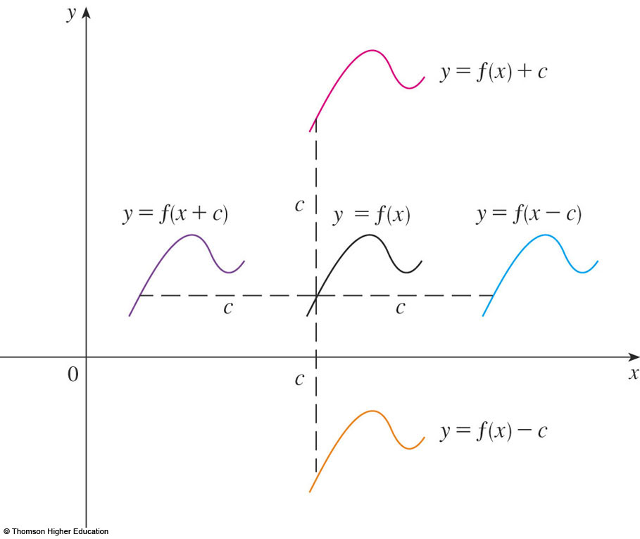
Shifting
(Suppose c > 0)
f(x) ⇒ f(x) + c: shift the graph of
y = f(x) c units to upward.
f(x) ⇒ f(x - c): shift the graph of
y = f(x) c units to the right.
Notes:
f+c; f-c

Slide 32
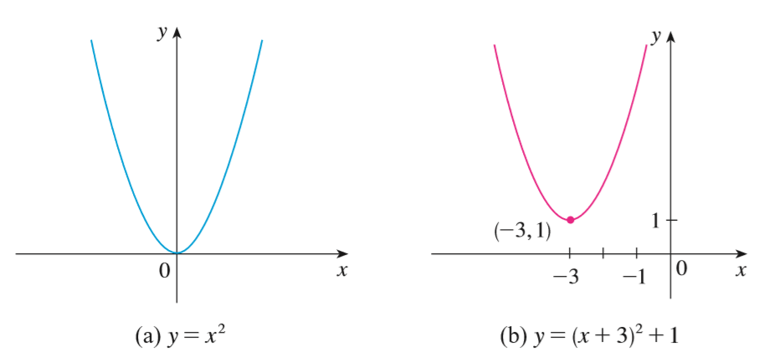
Shifting – example
Step 1. f(x) ⇒ f(x + 3)
Step 2. f(x+3) ⇒ f(x+3) + 1

Slide 33
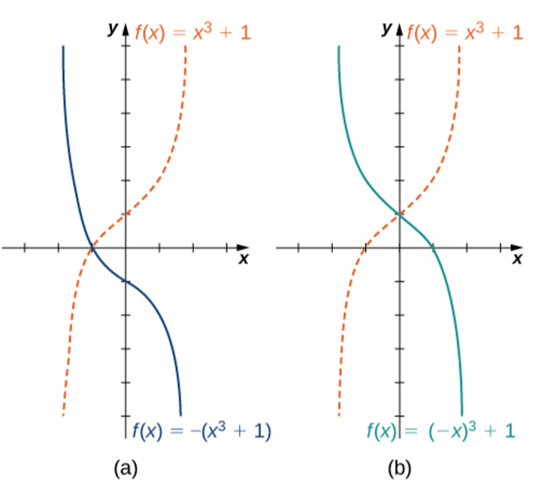
Reflections
f(x) ⇒ −f(x): reflect the graph of y= f(x) about the x-axis.
(b) f(x) ⇒ f(−x): reflect the graph of y= f(x) about the y-axis.
f(x) ➔ -f(x)
f(x) ➔ f(-x)

Slide 34

f(x) ⇒ |f(x)| rule
Keep the part of the graph when it lies above x-axis.
Reflect the part below x-axis about the x-axis.

Slide 35
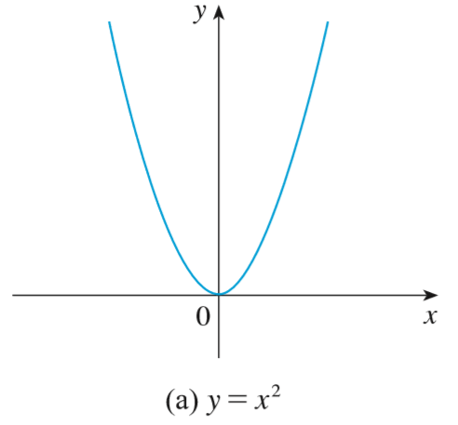
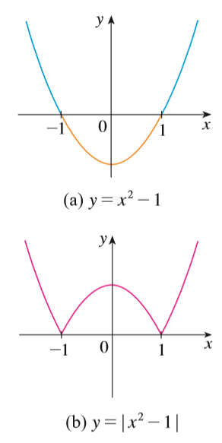
f(x) ⇒ |f(x)|
Ex. Sketch the graph of the function y = |x² - 1|.
Step 1. Graph y = x².
Step 2. Shift 1 unit down.
Step 3. Apply f(x) ⇒ |f(x)| rule.

Slide 36
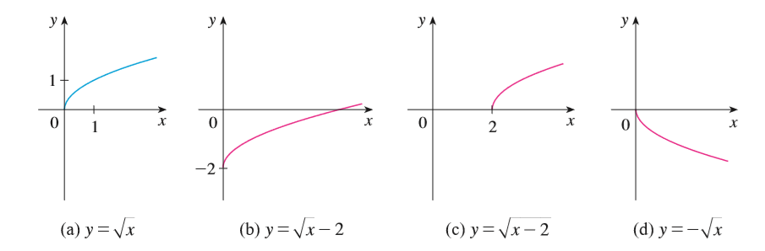
Transformations - Quiz

Slide 37
Exercise
1/ Suppose the graph of y = f(x) is given. How can we obtain the graph of
y = f(x + 3) + 2?
2/ Describe how the function f(x)= −(x+1)² − 4 can be graphed using the graph of y= x² and a sequence of transformations.

Slide 38
True-False Quiz
If is a function, then f(a + b) = f(a) + f(b).
If is a function, then f(3x) = 3f(x).
Shift the graph of f to the right 3 units to obtain the graph of f(x + 3).
If f is odd, then f(x) + f(-x) = 0.
f□g = g□f, assuming f and g are functions.

Slide 39
Summary
Function: a set of inputs, a set of outputs, and a rule for mapping each input to exactly one output.
Zeros of f: solutions of the equation f(x) = 0.
Odd function: f(−x)= −f(x) for all x in the domain of f.
Even function: f(−x)= f(x) for all x in the domain of f.
Transformations of functions: shifting, reflections.
Composition of functions: (g□f)(x):= g(f(x)).

Slide 40
THANKS

